Slide 1
Lesson objective
Aim:
To calculate the perimeter and area of composite shapes.
PLAN:
1. Daily review area of sectors
2. Demonstration of calculating composite shape area
3. Worksheet
PLAN:
1. Daily review area of circles
2. Demonstration of calculating composite shape area
3. Worksheet

Slide 2
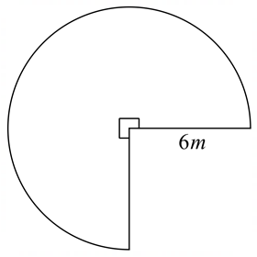
1. Calculate the area of this sector.

Slide 3
2. Calculate the area of this semi circle.
16cm

Slide 4
3. Calculate the area of this sector.
10cm

Slide 5
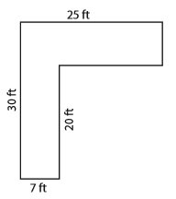
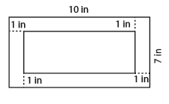
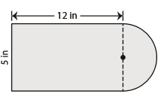
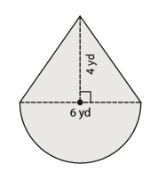
Composite shapes are shapes made up form other geometric shapes. Perimeter: is still add up the exterior sides. Area: is add (or sometimes subtract) the area of the shapes a composite shape is made of.

Slide 6
Steps for composite area
Identify and label each shape
Calculate area of each shape (4d.p)
Add or subtract area for answer (2 d.p)

Slide 7
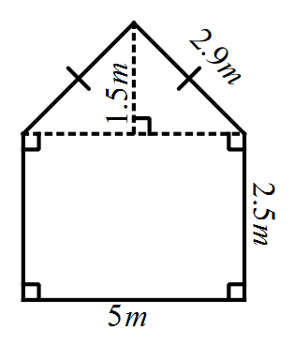
Identify and label each shape
Calculate area of each shape (4d.p)
Add or subtract area for answer (2 d.p)
1. Calculate the area of this composite shape.

Slide 8
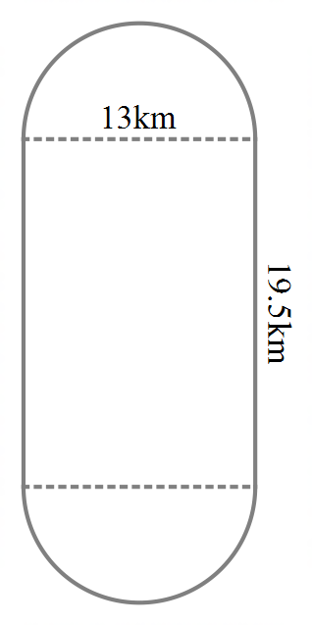
Identify and label each shape
Calculate area of each shape (4 d.p)
Add or subtract area for answer (2 d.p)
2. Calculate the area of this composite shape.

Slide 9
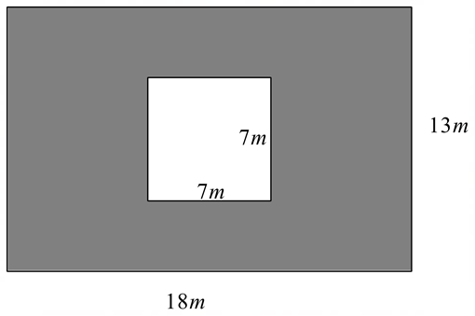
Identify and label each shape
Calculate area of each shape (4d.p)
Add or subtract area for answer (2 d.p)
3. Calculate the area of this composite shape (the shaded part).

Slide 10
Individual task practice
Complete questions a – f
(Unit 5 EXCEL 93-94)

